Slide 1
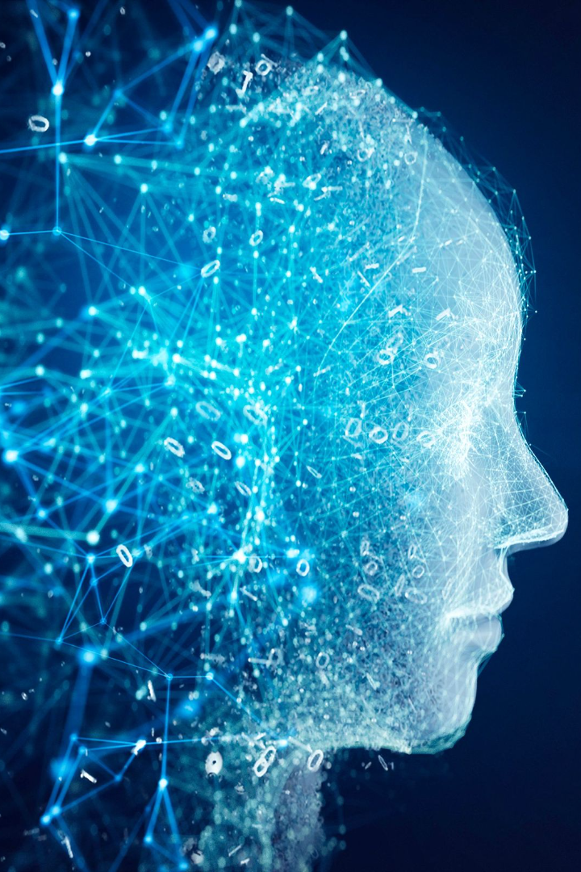
Generative AI
Anshu Pandey

Slide 2

Anshu Pandey
AI & Data Consultant
Formerly Progarm Director at Bootup Ventures
10+ years into Analytics, AI & Automation
Microsoft Certified Trainer, Wiley Certified Trainer
Consulted to 30+ organizations in Telecom, Finance and Education industry.

Slide 3

What is AI?
The capability of a machine to imitate intelligent
human behavior.

Slide 4
What is AI?
Machine
or Computers
Artificial Intelligence
+
Intelligence
=

Slide 5
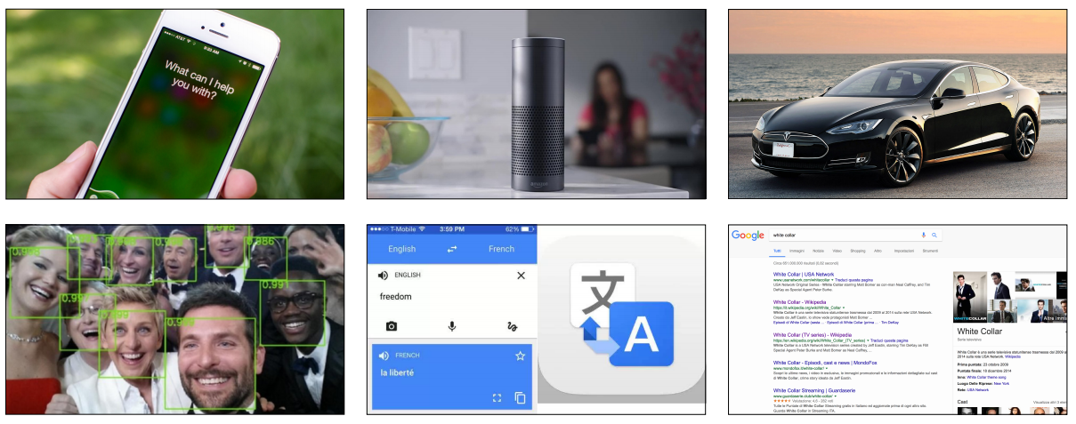
AI in our everyday products

Slide 6
The Need and Market Demand for AI
Identifying the driving factors behind the need for AI
AI's ability to analyze vast datasets, predict outcomes, and automate tasks has made it indispensable in sectors like finance, healthcare, and e-commerce.
Current market trends and demand for AI technologies
By 2025, the AI market is expected to exceed $190 billion, driven by innovations in machine learning, natural language processing, and AI hardware.
Real-world examples of AI applications in different industries
Healthcare: Predictive analytics to forecast outbreaks.
Finance: Fraud detection using machine learning.
E-commerce: Personalized product recommendations.

Slide 7
What is generative AI?
Artificial Intelligence
1956
Artificial Intelligence
the field of computer science that seeks to create intelligent machines that can replicate or exceed human intelligence
Machine Learning
1998
Machine Learning
subset of AI that enables machines to learn from existing data and improve upon that data to make decisions or predictions
Deep Learning
2014
Deep Learning
a machine learning technique in which layers of neural networks are used to process data and make decisions
2018
Generative AI
Create new written, visual, and auditory content given prompts or existing data.
Generative AI

Slide 8
History of Generative AI
Early Developments
Advancements in AI
Generative AI in Image
Generative AI in Text
1950s
1980s
2006s
2010s
2015
2018
2018
2020
Early AI Concepts and theories
Rise of neural networks
Revival of deep learning
Breakthroughs in deep neural networks
DeepDream by Google
GANs became popular for image generation (2014-18)
GPT by OpenAI, BERT by Google
GPT3, Advance NLP

Slide 9
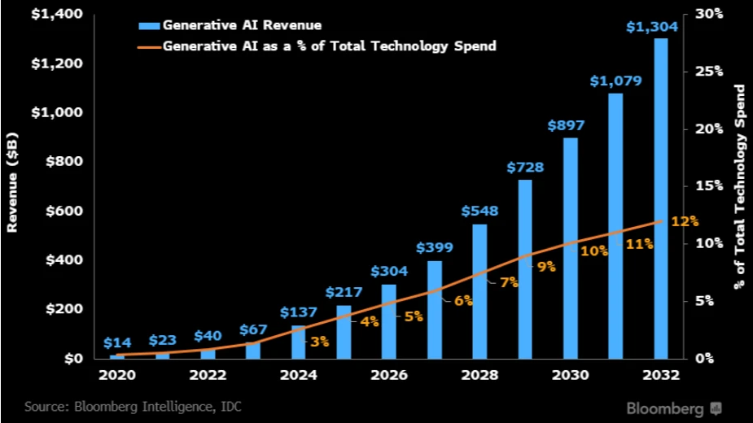
Generative AI Market trends
By 2032, more than 12% of technology spend will drive towards spends on Generative AI solutions.

Slide 10
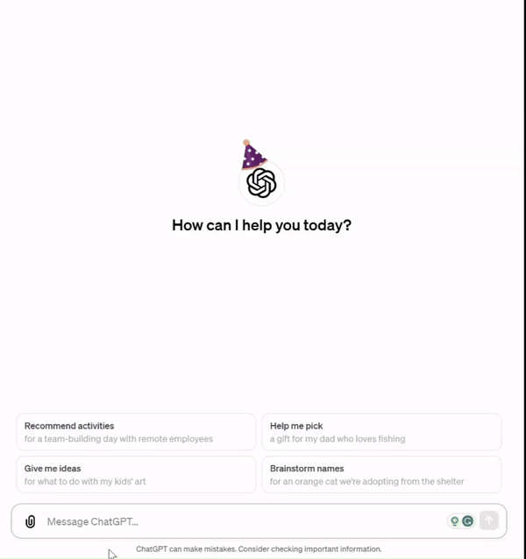
What is Generative AI?
1
Creative Potential 🎨
2
Unleashing Imagination ✨
Generative AI refers to machine learning algorithms that can create unique and original content, including images, music, and text.
This technology allows us to generate new ideas and possibilities, driving innovation and pushing the boundaries of what's possible.
3
Simulating Human Creativity 🧠
Generative AI models attempt to replicate human-like creative processes, delivering outputs that resemble creations made by humans.

Slide 11
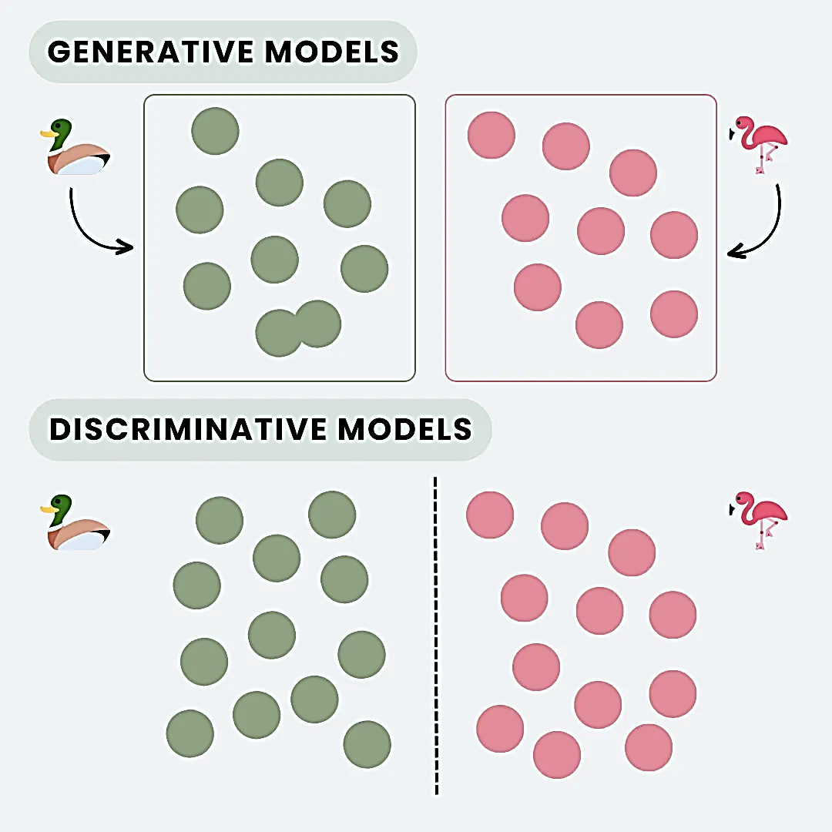
Generative AI vs. Discriminative AI
Aspect | Discriminative AI | Generative AI
Data Requirements | Requires labeled data for training (supervised learning). | Can learn from both labeled and unlabeled data.
Data Generation | Cannot generate new data samples. | Capable of generating new, synthetic data samples that resemble the training data.
Training Efficiency | Usually more efficient and faster to train due to simpler objectives. | Training can be more resource-intensive and time-consuming.
Interpretability | Often more interpretable as they focus on relationships between input features and output. | Typically, less interpretable due to the complexity of the models and their internal representations.
Examples | Logistic regression, Support Vector Machines (SVM), Decision Trees, Random Forests. | Generative Adversarial Networks (GANs), Variational Autoencoders (VAEs), certain types of Neural Networks.

Slide 12



Key Organizations
Several key organizations have played crucial roles in initiating and advancing developments in Generative AI. Here are some notable organizations:
Developed the groundbreaking GPT series for natural language processing and DALL-E for image generation.
Advanced deep learning and neural networks, and developed TensorFlow, a major machine learning framework.
Pioneered AI-generated graphics and deep learning with GPUs and created the StyleGAN series.

Slide 13



Key Organizations
Conducted extensive research in AI, including natural language and computer vision, and developed large-scale AI projects.
Created the Transformers library, a cornerstone in natural language processing.
Specialized in AI-powered coding assistants for enhanced programming efficiency.

Slide 14





Key Organizations
Developed AI tools for creative processes, focusing on artistic and design applications.
Focused on stable and scalable AI solutions, especially in image and text generation.
Influential in deep learning research, especially in generative models.
Advanced natural language understanding and generation, enhancing text-based AI applications.

Slide 15

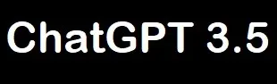

Text Generation
BERT (Bidirectional Encoder Representations from Transformers):
Introduced in 2018 by Google AI, BERT is a pre-trained model that revolutionized NLP. Unlike previous models that focused on word-level relationships, BERT uses a bidirectional approach, considering the context of both preceding and subsequent words to understand their meaning.
This significantly improved the accuracy of various NLP tasks, including text classification, sentiment analysis, and question answering.
GPT-3 (Generative Pre-trained Transformer 3): A massive model with 175 billion parameters, excelling in understanding and generating contextually relevant text.
GPT-3 has been utilized to automatically generate articles, blog posts, and creative content based on prompts.

Slide 16



Image Generation
Image generation models are a fascinating area of artificial intelligence that focus on creating new images, often from textual descriptions or by modifying existing images.
Text Prompt
Image Generation Model
Image

Slide 17
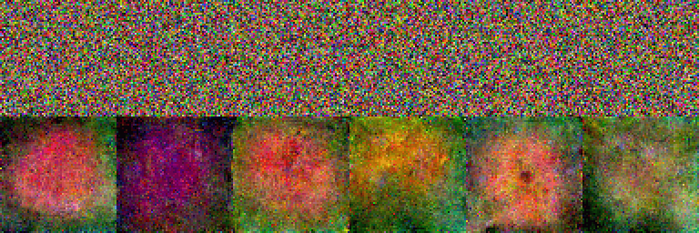
Image Generation
progression from early image recognition to sophisticated image generation.
AlexNet (2012)
GANs (2014)
DALL-E (2021)
Stable Diffusion (2022)
Deep learning breakthrough for image classification.
First system to generate highly realistic images.
Text-to-image generation with unprecedented quality and diversity.
Open-source diffusion model democratizing image generation.

Slide 18

Image Generation: Techniques
Generative Adversarial Networks (GANs)
Structure
Comprises two neural networks, the generator and the discriminator, which are trained simultaneously.
Function
The generator creates images, and the discriminator evaluates them. The generator learns to produce more realistic images over time to 'fool' the discriminator.
Variational Autoencoders (VAEs)
Structure
Consists of an encoder and a decoder.
Function
The encoder compresses the input into a latent (hidden) space representation, and the decoder reconstructs the input image from this latent space.
Diffusion Models
Structure
Based on a process that gradually adds noise to an image and then learns to reverse this process.
Function
Starts with a pattern of random noise and gradually shapes it into an image by learning from a dataset of images.

Slide 19

Audio Generation
Era | Key Technologies | Advancements | Applications
1950s-1970s | Rule-based systems | Concatenation of pre-recorded speech units (phonemes, diphones) | - Text-to-speech (TTS) for basic communication aids
1980s-1990s | Statistical parametric methods | Formant synthesis: synthesizes speech by controlling vocal tract parameters | - TTS with improved intelligibility and naturalness
2000s-2010s | Deep learning with neural networks | WaveNet: first system to generate raw audio waveforms with high fidelity | - Improved TTS systems with emotional expressiveness and speaker individuality
2010s-2020s | Generative Adversarial Networks (GANs) & Diffusion models | AudioStyleTransfer: allows for changing the style of existing audio | - Music composition and generation, sound effects creation, voice editing, and audio effects processing
2020s-present | Large language models (LLMs) | Integration of LLMs with audio generation models for natural and context-aware audio creation | - Personalized audio experiences, interactive storytelling, multi-modal learning, and creative audio content generation
Notes:
Early speech synthesis systems were limited in their vocabulary and expressiveness, sounding robotic and unnatural.
Statistical parametric methods significantly improved intelligibility and naturalness, but still lacked emotional range and speaker individuality.
Deep learning advancements with WaveNet led to a revolution in audio generation, enabling realistic and expressive speech synthesis.
GANs and diffusion models expanded audio generation capabilities beyond speech, allowing for style transfer, music composition, and sound effects creation.
LLMs like Jukebox and AudioML further enhance audio generation with their ability to understand and respond to textual prompts and context, leading to personalized and interactive audio experiences.

Slide 20
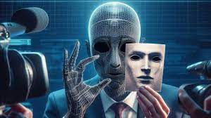
Video Generation
Deepfake technology emerged in the early 2010s with the development of deep learning algorithms capable of generating realistic synthetic media, including images, videos,
key events in Deepfake history:
2014
The term "deepfake" is coined by Ian Goodfellow, a researcher at Google Brain.
2017
The first widely-known deepfake video goes viral. It depicts former U.S. President Barack Obama giving a speech he never made.
2018-Present
Deepfake technology becomes increasingly sophisticated and accessible. There are more and more incidents of deepfakes being used for malicious purposes, such as spreading misinformation, damaging reputations, and committing fraud.
Deepfakes are a powerful technology with the potential for both good and bad. It is important to be aware of the ethical considerations surrounding deepfakes and to take steps to mitigate the risks of their misuse.

Slide 21
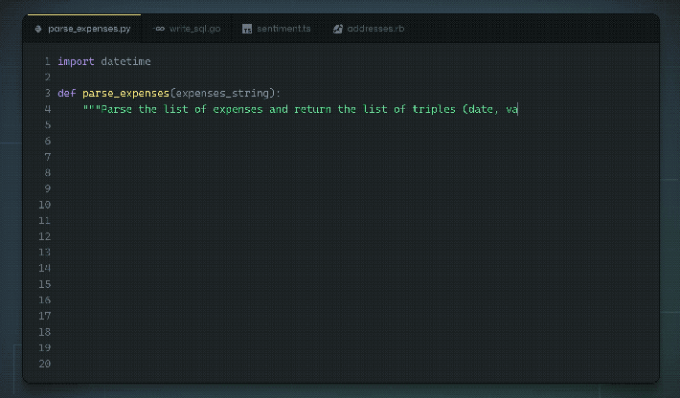
Code Generation
Code generation has become a powerful tool for developers, automating repetitive tasks and improving development efficiency. Today, various code generation engines, models, and applications are available, each with its own strengths and weaknesses.
Code Generation Engines:
General-purpose:
GitHub Copilot
TabNine
Kite
Specialized:
CodeT5
NL2Code
TensorFlow CodeGen
Code Generation Models
Transformer-based models
Recurrent Neural Networks (RNNs)
Rule-based models
Template-based
Grammar-based
Examples of applications:
Web development: Generating HTML, CSS, and JavaScript code for basic components.
Mobile development: Creating boilerplate code for Android and iOS applications.
Data analysis: Generating Python code for data cleaning and manipulation tasks.
Machine learning: Generating code for training and deploying machine learning models.

Slide 22
Applications of Generative AI
Art and Design 🎨
Music Composition 🎶
Generative AI is used to create stunning visual artworks, patterns, and designs, pushing the boundaries of creativity.
This technology helps composers generate new musical pieces, exploring different genres and styles.
Virtual World Creation 🌍
Content Generation 📝
Generative AI is utilized to generate realistic landscapes, buildings, and characters for video games and virtual reality experiences.
From automated article writing to personalized product descriptions, generative AI assists in generating relevant and engaging content.

Slide 23


Language Models
1
What is a Language Model?
2
Why are Language Models Useful?
A computer program that can generate human-like language. It learns the linguistic patterns of a dataset to generate new text based on a given prompt.
They can automate language-related tasks, such as translation, summarization, and answering questions.
3
What are the Different Types of Language Models?
Statistical, Neural, and Transformer models, with the latter being the most recent and widely used.

Slide 24
What are Large Language Models?
1
Definition
Language models trained on a massive amount of data, with billions or even trillions of parameters. Examples include GPT-3 and T5.
Size Comparison
2
Small language models have around 100 million parameters, while the largest ones can have up to 175 billion parameters.
3
Impact
Large language models achieve impressive performance on diverse tasks, such as translation, summarization, conversation, and even coding.

Slide 25



Working of LLMs
Transformer Models trained in self-supervised approach
Unlabelled text data
Language Models
All the Transformer models mentioned above (GPT, BERT, BART, T5, etc.) have been trained as language models.
This means they have been trained on large amounts of raw text in a self-supervised fashion.
Self-supervised learning is a type of training in which the objective is automatically computed from the inputs of the model. That means that humans are not needed to label the data!

Slide 26

Applications of Language Model
Sentiment analysis and text classification.
Text generation, like creating articles or stories.
Language translation.
Chatbots and virtual assistants.

Slide 27

Pre-trained LLMs
A. Why Pre-trained Models?
Training LLMs requires huge computational resources. By using pre-trained models, you leverage the training done by others, saving time and resources.
B. Common LLMs:
GPT (Generative Pre-trained Transformer): Developed by OpenAI, known for its capability to generate coherent, diverse paragraphs of text.
BERT (Bidirectional Encoder Representations from Transformers): Developed by Google, excels at understanding the context of words in search queries.
T5 (Text-to-Text Transfer Transformer): Also by Google, it treats every problem as a text-to-text problem.
C. How to Use:
APIs: Companies like OpenAI offer APIs to directly use their models.
Frameworks: Libraries like TensorFlow and PyTorch allow you to load pre-trained models and fine-tune or use them directly.

Slide 28
Introduction to Prompt Engineering
Prompt engineering is the art of crafting precise and effective prompts to guide the generative AI models in generating desired outputs.

Slide 29
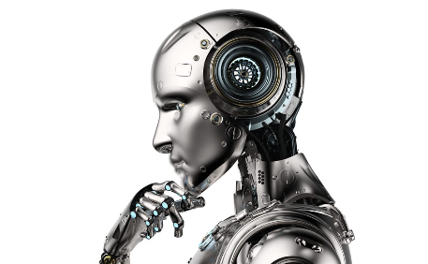

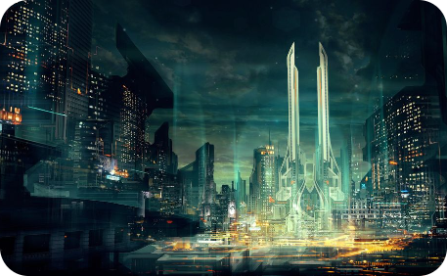
Example of Prompt Engineering
Generating AI-Assisted Robots 🤖
Creating Abstract Digital Art 🖼️
Designing Futuristic Cityscapes 🏙️
Prompt: "Design a robot that assists humans in their everyday tasks, enhancing their quality of life."
Prompt: "Generate an abstract artwork that evokes a sense of tranquility and wonder."
Prompt: "Imagine a futuristic cityscape that represents a utopian vision of society."

Slide 30
Prompt Engineering and its Significance
1
What is Prompt Engineering?
Prompt engineering is a process of selecting the right prompts to create the desired output from a generative AI model.
2
Importance of Good Prompts
Well-crafted prompts can significantly influence generative AI model behaviour. They can impact the accuracy and creativity of generated outputs.
3
Examples of Good Prompts
Good prompts should be clear, concise, and specific. For example, "generate a painting of a sunset over the ocean with vibrant colors and a diagonal composition."

Slide 31
Core features and functionalities of ChatGPT platform
ChatGPT act as a potential language generating model that manages various NLP tasks such as
Text Generation
ChatGPT is competent in generating text that appears to be generated by human. Useful for writing, content creation, etc.
01
Dialogue Generation
02
Prepare responses in a conversation-like manner. Useful for building chatbots and offering virtual assistance
Salient features of ChatGPT
Language Translation
03
Chat-GPT is fine-tuned for language translation tasks. Useful for chatbot or customer service applications
Optimum quality responses to queries
Large- scale training
Generate dynamic and in-depth virtual responses for each task assigned in written form
Offer better conversational communication
Platform is trained on huge amount of textual data enabling it to offer wide range of responses
Competent in completing tasks related to text generation, translation, summarization, etc.
Functionalities of ChatGPT
Text Summarization
04
Fine-tuned for text summarization tasks. Useful for new articles, detailed documents, etc.
01
02
05
Text Classification
Model can be modified for text classification task. Useful for sentiment analysis, intent recognition, and additional NLP applications
04
03
Adaptability
Use of ChatGPT
ChatGPT can be modified or fine-tuned to perform certain tasks with specific training
Potential in code writing and debugging, capable in writing poems, songs, essays & articles
06
Question Answering
Model can be tweaked for question-answering assignments. Useful for chatbots and customer service applications
07
Text Completion
Model can be modified for text-completion assignment. Useful for predictive text input and additional applications.

Slide 32
Providing clear instructions
Write a product description for a new water bottle
Write a product description for a new water bottle that is 100% recycled. Be sure to include that it comes in natural colors with no dyes, and each purchase removes 10 pounds of plastic from our oceans
Introducing the latest addition to our product line - the innovative and eco-friendly water bottle. Made from high-quality, BPA-free materials, this bottle is designed to keep your beverages at the perfect temperature for hours. Its sleek and stylish design makes it the perfect accessory for any outdoor activity or workout session. With its convenient carrying handle and leak-proof lid, you can take it with you wherever you go, without worrying about spills or leaks. Plus, its easy-to-clean design ensures that you can use it again and again, making it the perfect choice for anyone looking for a reliable and sustainable water bottle.
Introducing our newest water bottle, the eco-friendly choice for the conscious consumer. Made from 100% recycled materials and available in natural colors with no dyes, this bottle is not only stylish but also sustainable. Each purchase of this bottle removes 10 pounds of plastic from our oceans, making it a responsible choice for those who care about the environment. Its durable and leak-proof design makes it perfect for outdoor activities, while its easy-to-carry handle makes it convenient to take on the go. Join us in our mission to reduce plastic waste and choose this eco-friendly water bottle for your daily hydration needs.

Slide 33
Key elements of a prompt
Instruction
This is the core directive of the prompt. It tells the model what you want it to do. For example, "Summarize the following text" provides a clear action for the model.
Context
Context provides additional information that helps the model understand the broader scenario or background. For instance, "Considering the economic downturn, provide investment advice" gives the model a backdrop against which to frame its response.
Input data
This is the specific information or data you want the model to process. It could be a paragraph, a set of numbers, or even a single word.
Output indicator
Especially useful in role-playing scenarios, this element guides the model on the format or type of response desired. For instance, "In the style of Shakespeare, rewrite the following sentence" gives the model a stylistic direction.

Slide 34
Techniques in prompt engineering
Role-playing
By making the model act as a specific entity, like a historian or a scientist, you can get tailored responses. For example, "As a nutritionist, evaluate the following diet plan" might yield a response grounded in nutritional science.
Iterative refinement
Start with a broad prompt and gradually refine it based on the model's responses. This iterative process helps in honing the prompt to perfection.
Feedback loops
Use the model's outputs to inform and adjust subsequent prompts. This dynamic interaction ensures that the model's responses align more closely with user expectations over time.

Slide 35
Techniques in prompt engineering
Zero-shot prompting
This technique involves providing the model with a task it hasn't seen during its training. It tests the model's ability to generalize and produce relevant outputs without relying on prior examples.
Few-shot prompting/in-context learning
Here, the model is given a few examples (shots) to guide its response. By providing context or previous instances, the model can better understand and generate the desired output. For example, showing a model several examples of translated sentences before asking it to translate a new one.
Chain-of-Thought (CoT)
This advanced technique involves guiding the model through a series of reasoning steps. By breaking down a complex task into intermediate steps or "chains of reasoning," the model can achieve better language understanding and more accurate outputs. It's akin to guiding someone step-by-step through a complex math problem.

Slide 36
Create an adequate prompt
Clarity is key
Ensure that the prompt is clear and unambiguous. Avoid jargon unless it's necessary for the context.
Try role-playing
Making the model assume a specific role can yield more tailored responses.
Use constraints
Setting boundaries or constraints can help guide the model towards the desired output. For instance, "Describe the Eiffel Tower in three sentences" provides a clear length constraint.
Avoid leading questions
Leading questions can bias the model's output. It's essential to remain neutral to get an unbiased response.

Slide 37
Iterate & Evaluate
Draft the initial prompt
Based on the task at hand and the desired output.
Test the prompt
Use the AI model to generate a response.
Evaluate the output
Check if the response aligns with the intent and meets the criteria.
Refine the prompt
Make necessary adjustments based on the evaluation.
Repeat
Continue this process until the desired output quality is achieved.

Slide 38
Primary, supporting, and grounding content
Section markers
(--- or ###)
---
Thanks for your interest in our summer school program.
We’re looking for your ideas for webinars on topics such as AI, web development, … <more…>
---
Topics I'm very interested in: AI, webinar dates, submission deadlines
Extract the key points from the above email, and put them in a bulleted list
Primary content to be summarized, translated, etc.
Supporting content to provide clarity / specificity
---
Artificial Intelligence (AI) has evolved over many years … <more…>
---
Where and when did the field of AI start?
Grounding content to define scope for questions

Slide 39
Chain of thought
Ask a model to break down its response and explain its reasoning
What sport is easiest to learn but hardest to master? Give a step by step approach of your thoughts, ending in your answer
Step 1: Identify the criteria for "easy to learn" and "hard to master" sports.
For a sport to be considered easy to learn, it should have simple rules and require minimal equipment For a sport to be considered hard to master, it should require years of practice to perfect and have a large variety of techniques and strategies… Step 2: Consider different sports that fit these criteria.
Some sports that could be considered easy to learn but hard to master include:
Tennis: Simple rules, easy to pick up, but requires years of practice to master all the different shots and strategies.
Golf: Basic swing mechanics are easy to learn but perfecting them takes a lifetime of practice.
…
Step 3: Evaluate each sport based on the criteria.
Tennis and golf both require expensive equipment, which could make them less accessible to beginners. In terms of skill ceiling and time required to master, tennis and golf both have a high skill ceiling and require years of practice to perfect….
Step 4: Make a decision based on the evaluation.
Based on the above criteria and evaluation, I would say that tennis is the sport that is easiest to learn but hardest to master. While it may require expensive equipment, it is still accessible to many people. The basic rules and techniques are easy to learn, but mastering all the different shots and strategies takes years of practice…

Slide 40
Best practices for prompt engineering
1
Clarity & Specificity ✍️
2
Diverse Examples 🌈
The prompts should be clear and provide specific instructions to steer the generative AI model towards the desired output.
Providing a variety of relevant examples helps the model understand the task and potential variations in the output.
3
Iterative Process ♾️
Iteratively refining the prompts and evaluating the generated outputs are essential steps in optimizing the generative AI models.

Slide 41
Trends and Advancements
Transformative Technology
State-of-the-Art Research
Generative AI has the potential to revolutionize industries ranging from finance to healthcare, introducing new efficiencies and opportunities.
The field of generative AI is rapidly evolving, with new techniques and technologies emerging all the time.

Slide 42
The Future of Generative AI and Prompt Engineering
1
New Real-World Applications
Generative AI and prompt engineering may be applied to smart cities, autonomous vehicles, and more, shaping the future of our everyday lives.
Concerns and Pitfalls
2
Challenges such as data bias and malicious use of generative AI could pose significant risks to industries and societies.
3
Promising Future
The potential benefits of generative AI and prompt engineering show great promise in fueling innovation and improving our world.

Slide 43

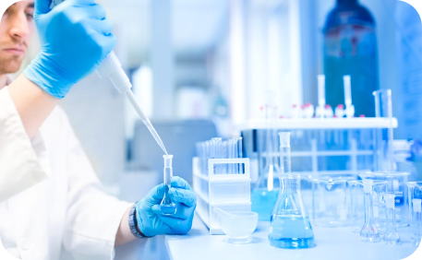

Future of Generative AI
Virtual Reality Fusion
Advancing Healthcare
Smart City Transformation
Generative AI will play a crucial role in creating immersive and interactive virtual reality experiences.
The potential of generative AI to assist in medical research, disease diagnosis, and drug discovery is immense.
Generative AI can drive the transformation of cities by generating sustainable, efficient, and user-centric designs.

Slide 44

Hugging Face API

Slide 45
What is hugging face?
Hugging Face is a company specializing in Natural Language Processing (NLP) and is known for its state-of-the-art Transformers library.
The Transformers library provides easy-to-use APIs for implementing popular architectures like BERT, GPT-2, T5, and many more.
It offers a platform for both pre-trained models and custom-trained models, making it widely popular among researchers, developers, and data scientists.

Slide 46
Hugging Face Hub
120k models
20k datasets
50k demo apps (Spaces)
All open source and publicly available, in an online platform where people can easily collaborate and build ML together.
The Hub works as a central place where anyone can explore, experiment, collaborate, and build technology with Machine Learning.

Slide 47
Hugging Face API applications
Text classification: Hugging Face can be used to train and deploy text classification models for a variety of tasks, such as sentiment analysis, spam detection, and topic classification.
Question answering: Hugging Face can be used to train and deploy question answering models that can answer questions about a given text passage or knowledge base.
Machine translation: Hugging Face can be used to train and deploy machine translation models that can translate text from one language to another.
Text summarization: Hugging Face can be used to train and deploy text summarization models that can generate summaries of long text passages.
Code generation: Hugging Face can be used to train and deploy code generation models that can generate code in a variety of programming languages.

Slide 48
Text Classification with Hugging Face
Hugging Face Api can be used to deploy multiple tasks such as text classification, text summarization, tagging etc with the help of pipeline.
The pipeline() makes it simple to use any model from the Hub for inference on any language, computer vision, speech, and multimodal tasks.
from transformers import AutoModelForSequenceClassification, AutoTokenizer, pipeline
tokenizer = AutoTokenizer.from_pretrained("distilbert-base-uncased")
model = AutoModelForSequenceClassification.from_pretrained("distilbert-base-uncased")
nlp = pipeline("sentiment-analysis", model=model, tokenizer=tokenizer)
result = nlp("Hugging Face is an amazing company!")
print(result)

Slide 49
Summary
Artificial Intelligence
AI refers to machines performing tasks that usually require human intelligence, and its applications span various industries like healthcare, finance, and e-commerce.
Generative AI
Using systems like Generative Adversarial Networks (GANs) and Variational Autoencoders (VAEs), Generative AI can produce new, unseen content, revolutionizing creative fields such as art, music, and text generation.
Prompt Engineering
A technique that involves crafting specific inputs to AI models, especially language models, to guide them towards more accurate or contextually relevant answers. Its effective use can drastically improve AI outputs.
Ethical Considerations
As AI-generated content becomes pervasive, ensuring transparent, unbiased, and ethical AI practices is paramount to maintain public trust and meet regulatory standards.
Future Trends
Advancements in AI research, such as transfer learning and few-shot learning, combined with the evolution of Generative AI and prompt engineering, promise a future of more personalized and dynamic content generation across industries.

Slide 50
Questions

Slide 52
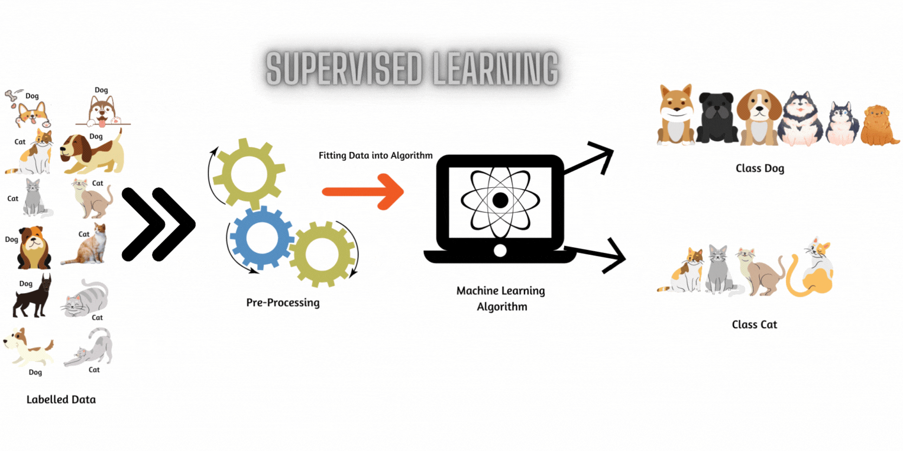
Types of Machine Learning(ML)
Supervised Learning: Supervised machine learning uses algorithms that learn from labeled data, where each data point includes input features and a corresponding label, to make predictions or decisions.
Primarily two types of problems we solve within supervised ML:
Classification
Regression
Classification: Classification is a task in supervised machine learning where input data is categorized into predefined labels based on features.
Regression: Regression is a supervised learning technique used to predict continuous numerical values from input variables.

Slide 53
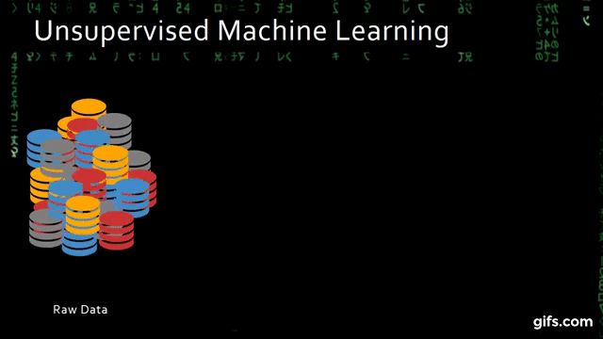
Types of Machine Learning(ML)
Unsupervised Learning: Unsupervised learning involves training algorithms on data without labeled targets, aiming to uncover hidden patterns or relationships, unlike supervised learning which uses specific labeled data for prediction or classification.
Some key problems within unsupervised ML are:
Clustering
Dimensionality Reduction
Association Rule Mining
Clustering: Clustering is the process of grouping similar data points using their characteristics in unsupervised learning.
Dimensionality reduction: Dimensionality reduction aims to simplify datasets by reducing features while maintaining critical information.
Association Rule Mining: Association Rule Mining identifies hidden patterns and relationships within transactional or categorical datasets.

Slide 54

Types of Machine Learning(ML)
Reinforcement Learning: is a type of machine learning paradigm that focuses on training agents to make a sequence of decisions in an environment in order to maximize a cumulative reward signal. It is commonly used in situations where the optimal action is not known beforehand, and the agent must explore and learn from interactions with the environment.
Reinforcement Learning (RL) can be categorized into several types and approaches, depending on the problem setting and learning methodology. Here are some of the types of RL:
Model-Free RL
Model-Based RL
Deep Reinforcement Learning
Inverse Reinforcement Learning
Multi-Agent Reinforcement Learning (MARL)
Imitation Learning
Transfer Learning
Meta-Learning

Slide 55

Applications of Machine Learning(ML)
Supervised Learning: Sentiment Analysis, Spam Detection, Image Classification, Predictive Analytics, Medical Diagnosis, etc.
Unsupervised Learning: Customer Segmentation, Anomaly Detection, Document Clustering, Feature Selection, Data Visualization, Data Visualization, etc.
Reinforcement Learning: Robotics, Game Playing, Recommendation Systems, Autonomous Vehicles, Natural Language Processing, Drug Discovery, Adaptive Treatment Planning, etc.

Slide 56
Deep Learning (DL): Deep Learning is a subset of Machine Learning, where neural networks — algorithms inspired by the human brain — learn from large amounts of data.. Deep Learning can automatically learn and improve from experience without human intervention.

Slide 57
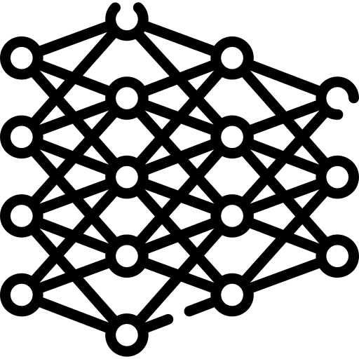
Neural Networks
Neural networks in deep learning are inspired by the structure and function of the human brain.
Just as the brain is composed of neurons interconnected by synapses, neural networks consist of units (or nodes) connected by weights.

Slide 58
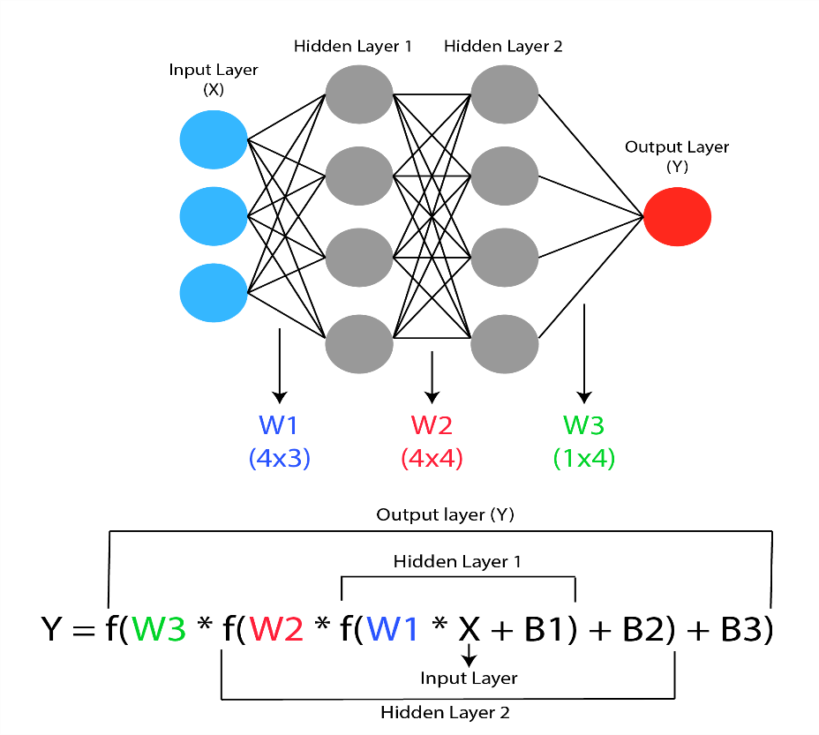
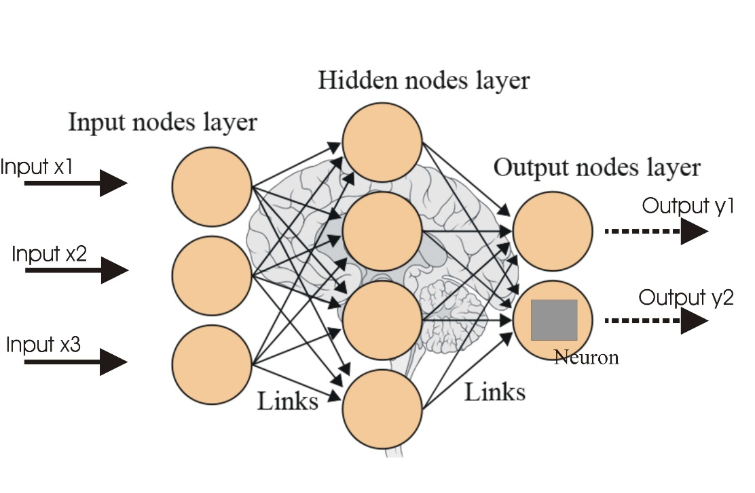
Units and Layers in Neural Networks
Units(or nodes) and Layers: These networks are structured in layers.
Input Layer: Receives the initial data.
Hidden Layers: Perform computations and transformations on this data. There can be one or many hidden layers.
Output Layer: Produces the final output, such as a classification or prediction.
Connections and Weights: Each connection between units has an associated weight, which is adjusted during training to optimize the network’s performance.

Slide 59
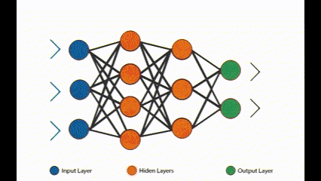

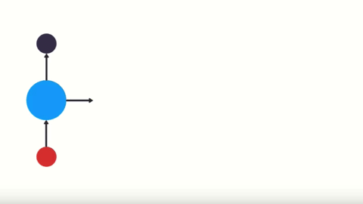
Types of Neural Networks:
Artificial neural network(ANN)
The simplest type of artificial neural network architecture. In this network, the information moves in only one direction forward from the input nodes, through the hidden nodes (if any), and to the output nodes
Convolutional Neural Networks (CNN)
Designed primarily for processing data with a grid-like topology, such as images. These networks have layers that specialize in identifying patterns in images.
Recurrent Neural Networks (RNNs)
Designed for sequential data like text or time series. They have a 'memory' of previous inputs in the sequence. These networks are with loops to allow information to persist.

Slide 60
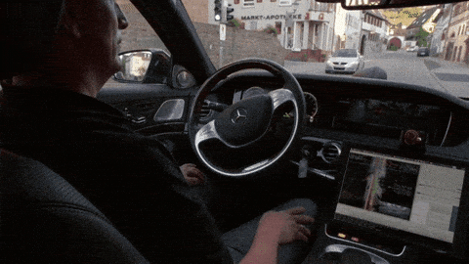
Applications of Deep Learning
Advanced image and speech recognition
Natural Language Processing (NLP)
Autonomous vehicles
Personalized content curation

